Slide 1
Optimizing a Linear Regression Model for House Price Prediction
Author: Ken Walsh

Slide 2
Introduction
Libraries used:
To create a multiple linear regression model to predictive future house sales price based on selected house features.
Statistics:
Sklearn - linear_model, r2_score
Scipy – skew
Visualization:
Matplotlib
Seaborn
General Data Manipulation:
Pandas
Numpy

Slide 3
The Data
Data:
Type of Data: Real Estate House Features
Initial Dataset:
Size & Shape: 100 x 82 matrix
R^2: 0.866598
Final Skew: 0.193989
Test Dataset:
Size & Shape: 100 x 82 matrix
R^2: 0.817934
Final Skew: -0.032614

Slide 4
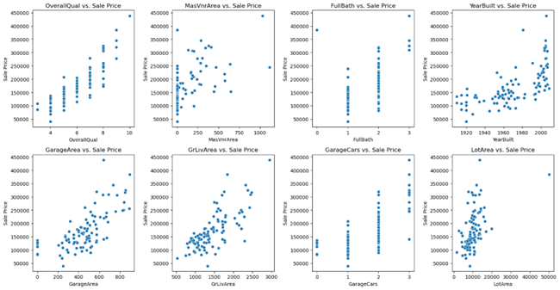
Data Exploration
Selected Variables Correlation Plots:

Slide 5
Data Preparation
Data Cleansing:
All NaNs & Nulls set to zero.
No reshaping required

Slide 6
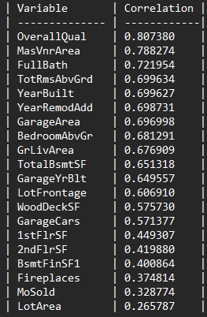
Correlation
Correlation Results for Top Twenty Variables

Slide 7
Project Description
Algorithm Used:
Multiple Linear Regression
Equation: y = m1x1 + m2x2 + ... + xnmn + b
Where:
y is the dependent variable (outcome variable or response variable).
x is the independent variable (predictor variable).
m is the slope of the regression line.
b is the intercept (y-axis intercept).

Slide 8
Analysis and Results
Variables Selected:
'OverallQual’ - High Correlation Score 0.807380
'MasVnrArea’ - High Correlation Score 0.788274
'FullBath’ - High Correlation Score 0.721954
'YearBuilt’ - High Correlation Score 0.699627
'GarageArea’ - High Correlation Score 0.696998
'GrLivArea’ - High Correlation Score 0.676909
'GarageCars’ - High Correlation Score 0.571377
'LotArea’ - Poor Correlation Score 0.265787*
* Removing this variable resulted in a 3 point drop in model score.
*Please add slides as required.

Slide 9
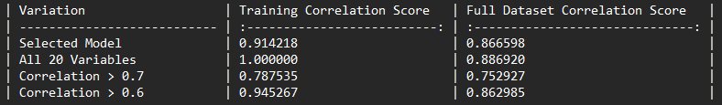
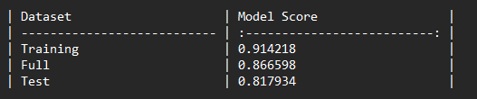
Verification
Summary:
Model Scores for Variation of Variables against Training and Full Datasets.
Model Scores for chosen variables against all datasets.

Slide 10
Conclusion
Conclusions:
Model Performance: R^2 score Training - 0.914218, Full - 0.866598, Test dataset - 0.817934.
Approach Comparison: Various variable combinations.
Blind Data Test: Tested well against blind data set – 0.817934.
Statistical Metrics: More metrics required, not just R^2.
Data Analysis Lessons: Importance of exploration and cleansing of data.
Continued Refinement: Additional datasets required

Slide 11
References
Use this as a sample for articles:
Author Last Name, Author First Name. “Article Title.” Journal Title Volume #, no. Issue # (year): page range.
Ex: Doe, John. “Data Engineering.” Data Engineering Journal 18, no. 4 (2021): 12-18.
Use this as a sample for websites:
Author Last Name, Author First Name. “Title of Web Page.” Name of Website. Publishing organization, publication or revision date if available. Access date if no other date is available. URL .
Doe, John. “Data Engineering.” Data Engineer Resource. Cengage, 2021. www.dataengineerresource.com .
*Please add slides as required.

